Slide 1
Artificial Bee Colony (ABC) Algorithm

Slide 2

Artificial Bee Colony (ABC) (History)
Artificial Bee Colony (ABC) is one of the most recently defined algorithms by Dervis Karaboga in 2005, motivated by the intelligent behavior of honey bees.

Slide 3
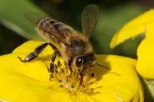
Artificial Bee Colony
The ABC algorithm is a swarm based meta-heuristics algorithm.
It based on the foraging behavior of honey bee colonies.
The artificial bee colony contains three groups of bee:
Employed bees
Onlookers
Scouts

Slide 4
Artificial Bee Colony (ABC)
The Employed Bee:
It stays on a food source and provides the neighborhood of the source in its memory.
The Onlooker Bee:
It gets the information of food sources from the employed bees in the hive and select food sources to gathers the nectar.
The Scout:
The employed bee whose food source has been abandoned becomes a scout and starts to search for finding a new food source.

Slide 5
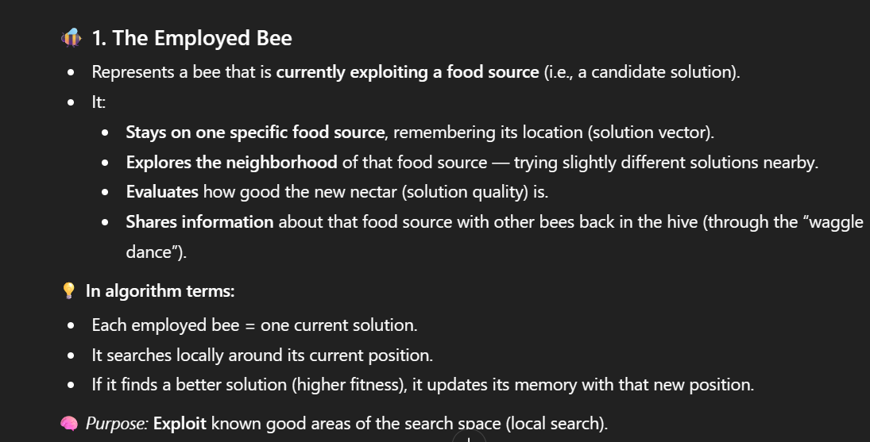

Slide 6
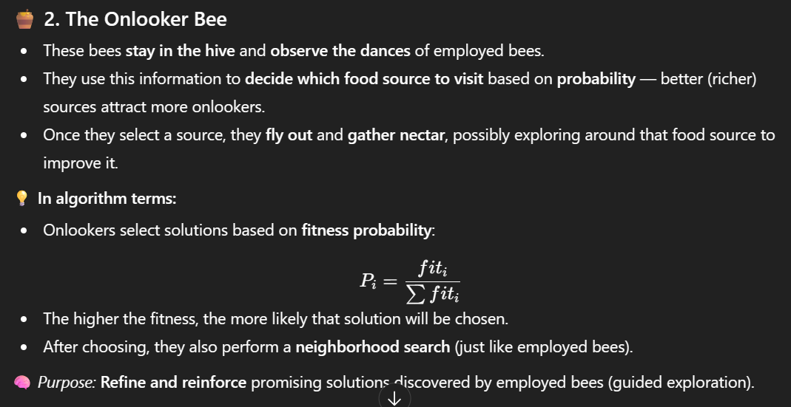

Slide 7
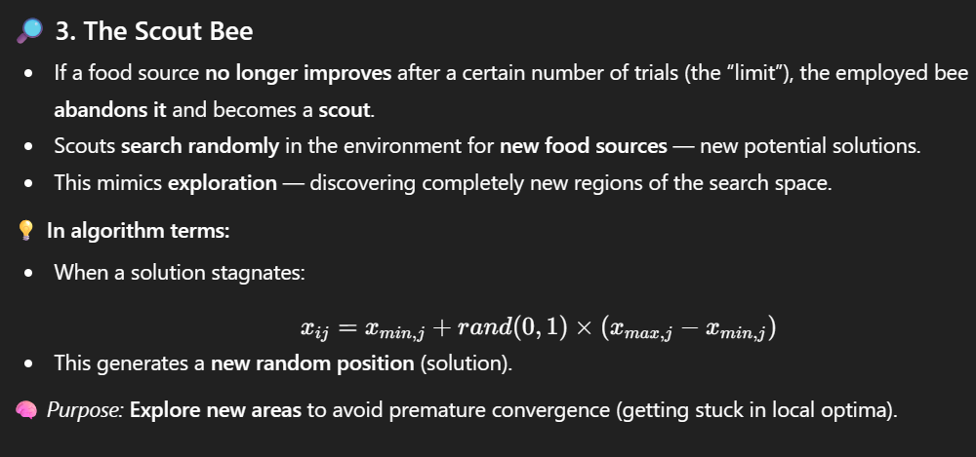

Slide 8
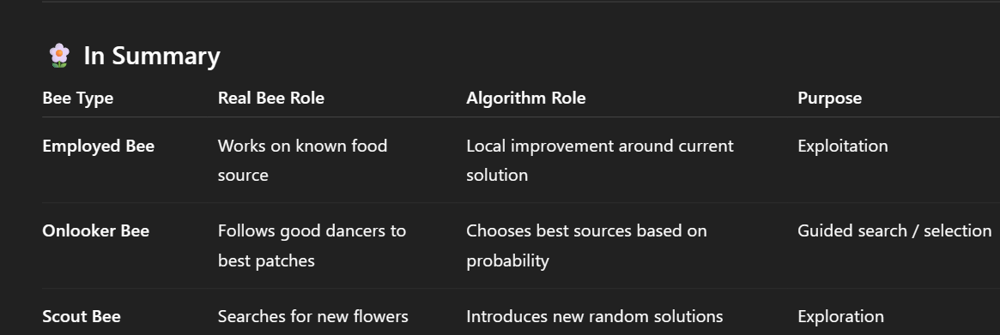

Slide 9
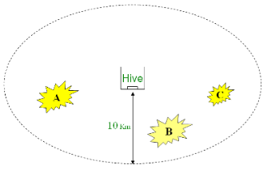
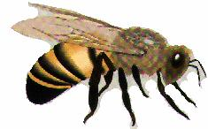
Bees in Nature
A colony of honey bees can extend itself over long distances in multiple directions (more than 10 km).

Slide 10
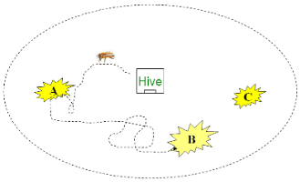
Bees in Nature
Employed bees go to their food source.

Slide 11
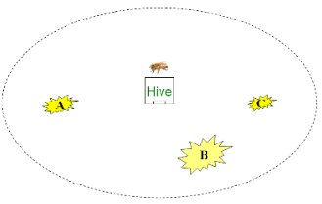
Bees in Nature
The employed bees who return to the hive, evaluate the different patches depending on certain quality threshold (measured as a combination of some elements, such as sugar content).

Slide 12
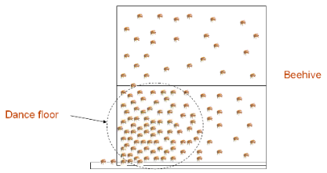
Bees in Nature
They go to the “dance floor” to perform a “waggle dance”

Slide 13
Bees in Nature
Bees communicate through this waggle dance which contains the following information:
    The direction of flower patches (angle between the sun and the flower patch)
    The distance from the hive (duration of the dance)
    The quality rating (fitness) (frequency of the dance)

Slide 14
Bees in Nature
These information helps the colony to send its bees precisely
Follower bees (onlooker bees) go after the dancer bee (employed bees) to the patch to gather food efficiently and quickly

Slide 15

Bees in Nature
Thus, according to the fitness, patches can be visited by more bees or may be abandoned
The employed bee whose food source has been abandoned becomes a scout and starts to search for finding a new food source

Slide 16
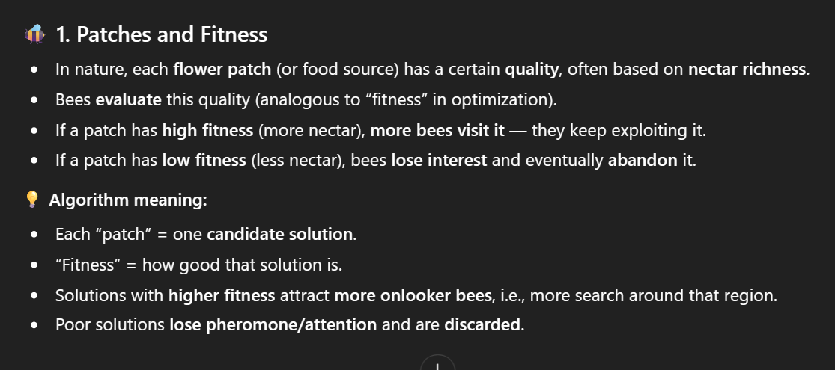
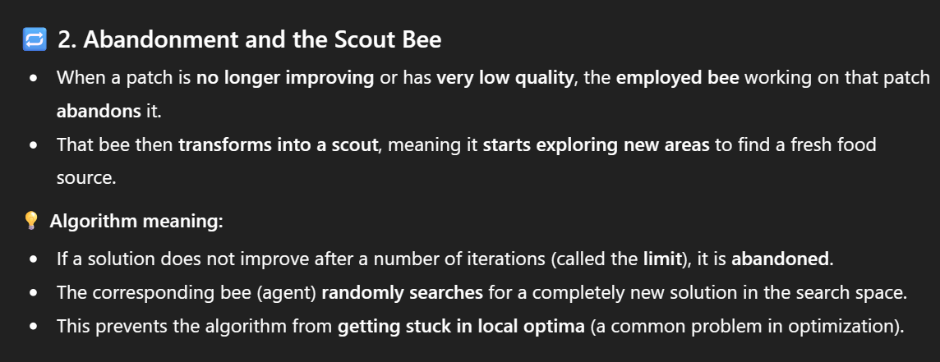

Slide 17








Bees in Nature
Hive
Dancing area for A
Dancing area for B
Picture form www.acclaimclipart.com , www.computerclipart.com

Slide 18
ABC Algorithm
Step 1: Assign control parameters
Step 2: Initialize solutions
Step 3: Repeat until stopping criteria is met
          Send the employed bee and calculate fitness
          Send the onlookers and calculate fitness
          Send the scout bees and calculate fitness
          Memorize the best solution
Step 4: Stop

Slide 19
ABC Algorithm
Foraging bee
employed
onlooker
Scout

Slide 20
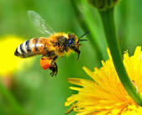
ABC control parameters
Swarm size (Total solutions)
Employed bees (50% of swarm)
Onlookers (50% of swarm)
Scouts (1 or can be more than 1)
Limit (for becoming a scout from an employed bee)
Dimension of the problem

Slide 21
Initial Solutions
Food source initialization
(Number of solutions = Employed bees)
Where,
i = 1,2,…,n
n = Food source
j = Dimension

Slide 22
Employed bee Phase
Send each employed bee to solutions/positions of flowers (Initial Solutions)
  Number of solutions = Employed bees = 5 (in this example)
  1 dimension (in this example)
Calculate fitness

Slide 23
Employed bee Phase (Cont.)
Evolve solution to neighborhood
      Where,
      = rand(-1, 1)
i = 1,2,…,n
n = Food source
j = Dimension
k = rand(1, n) != i
Evolved Solution
V_{i}
Solution
X_{i}
j=6
Single solution evolution
Select better solution comparing f(xi) and f(vi)

Slide 24
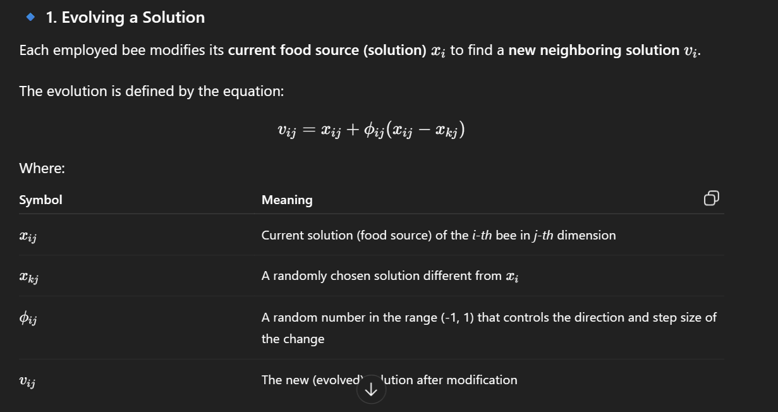
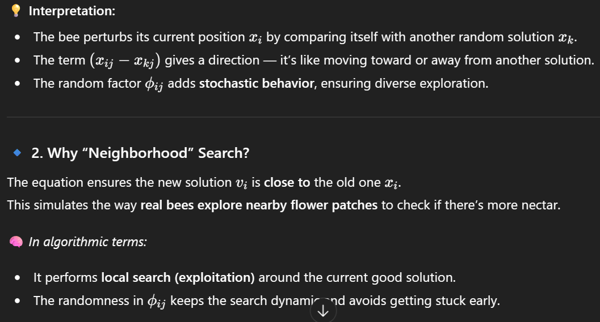

Slide 25
Onlookers Phase
Calculate probability for each solution
Select solution with respect to probability
Can use roulette wheel or other technique to make probabilistic nature for the exploration

Slide 26
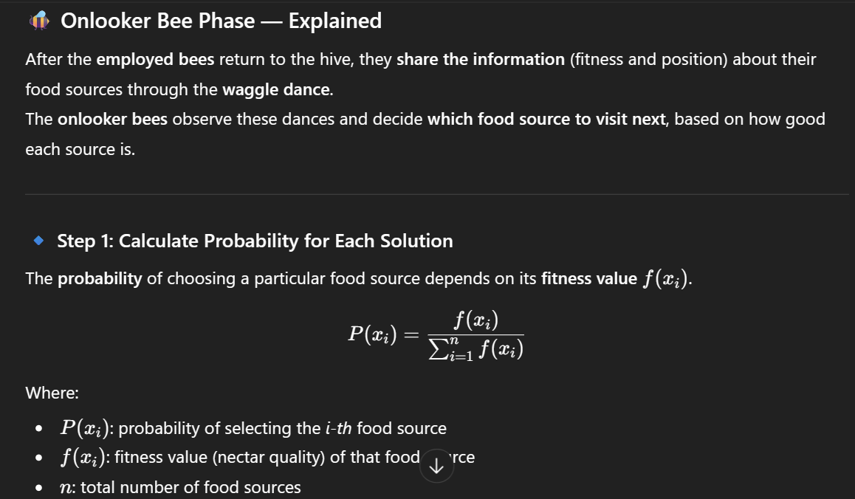

Slide 27
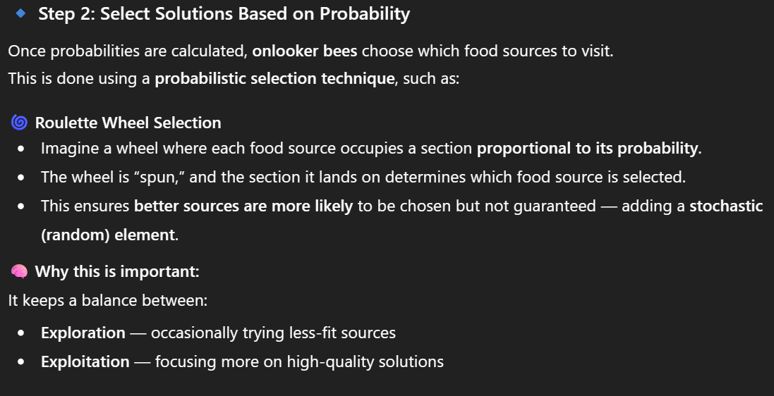

Slide 28
Onlookers Phase (cont.)
Evolve selected solution to neighborhood
Calculate f(vi)
Select better solution comparing f(xi) and f(vi)
(Same as Employed bee phase)
      Where,
      = rand(-1, 1)
i = 1,2,…,n
n = Food source
j = Dimension
k = rand(1, n) != i

Slide 29
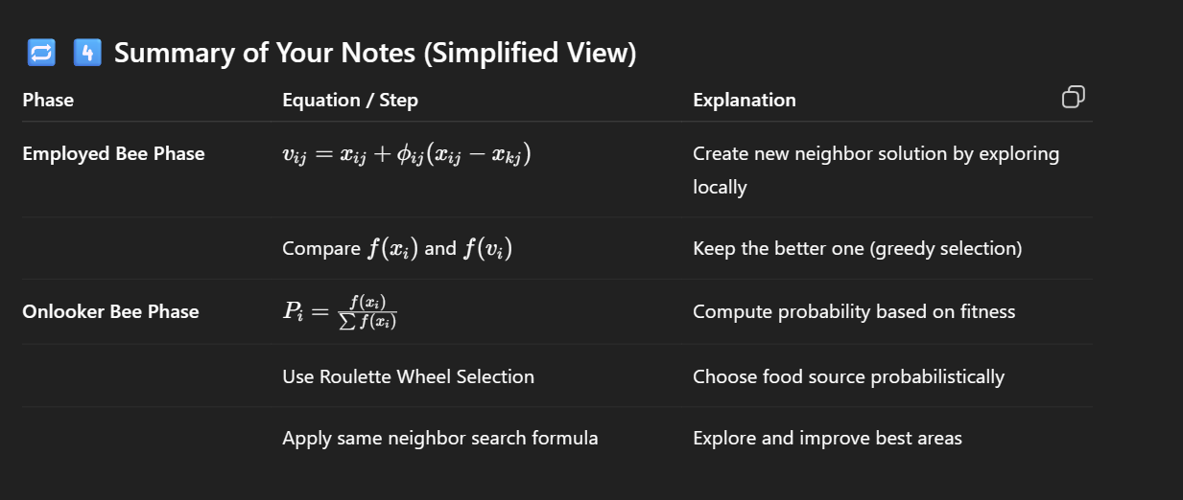

Slide 30
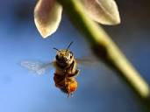

Scout Phase
In ABC, providing that a position can not be improved further through a predetermined number of cycles, which is called “limit” then that food source is assumed to be abandoned.
-some employed bees (food source abandoned) may become scouts to explore the search space by the following equation (same as initialization)

Slide 31
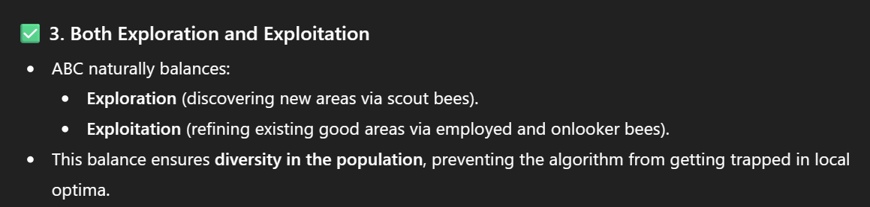
Advantages & Disadvantages
Advantages
  Few control parameters
  Fast convergence
  Both exploration & exploitation
Disadvantages
  Search space limited by initial solution

Slide 32
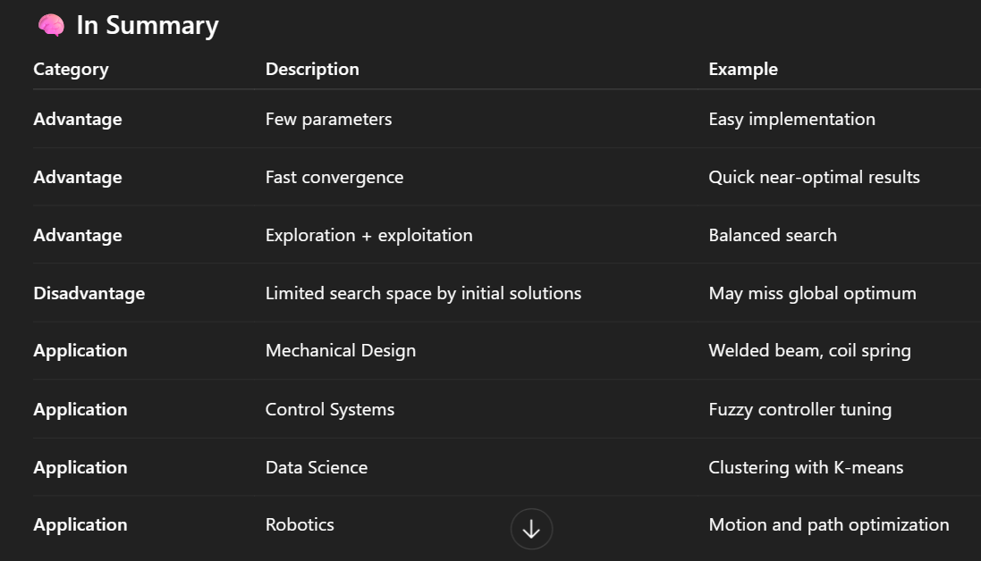

Slide 33
Applications
Mechanical designs like:
  Design of welded beam
  Design of coil spring
Digital Filter Optimisation
Fuzzy Control Design
Data Clustering (solving the local optimum for K-means algorithm)
Robot control

Slide 34
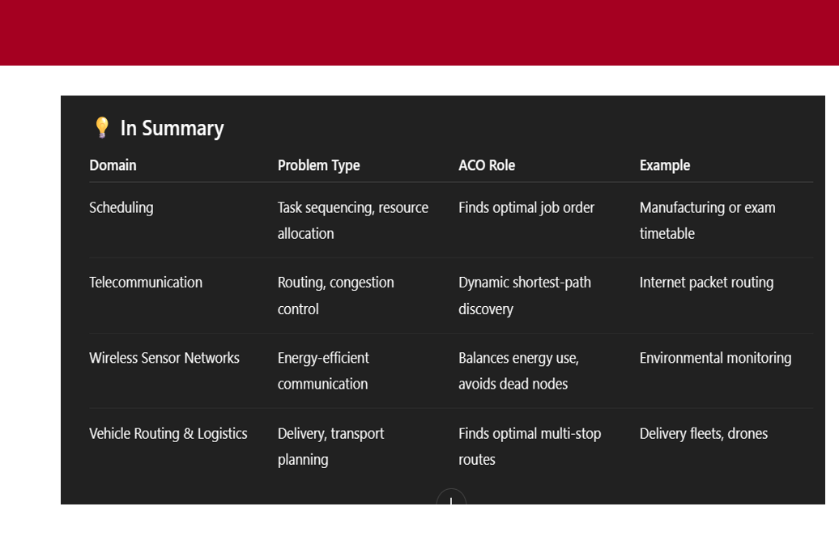

Slide 35
